Slide 1

BOOKIFY -LIBRARY MANAGEMENT SYSTEM
PREPARED BY
Asmita Paul
Amish Singh
Vritant Tiple
Siddhant Khare
Dev Singh Parihar
PREPARED FOR
JEE Full Stack with React JR_7
Sprint-1 Evaluation

Slide 2
INTRODUCTION
The Project Bookify, an Library management system is developed in Java (Spring Boot) , which mainly focuses on basic operations in a library like adding new books, updating new information searching books and members and facility to issue and return books using this web application user can make the booking of books online and can look for the book either it is available in library or not.
The Library management system designed in this project was developed using java as the programming languages and PostGRE SQL as the database Management system. The framework adopted for this project is the spring boot which is open source Java-based framework.

Slide 3
Problem Domain
People don’t have any particular platform where they can get and manage all the information they need.
People have to use handwritten ledgers which take a lot of time and are a hassle to maintain.
It is not a viable option to use handwritten ledgers in today’s digital world

Slide 4
Solution Domain
We aim to provide our users the perfect tour of the library without any struggle.
One place for all the Information.
The purpose of our website is to facilitate the users by managing and maintaining all the data and relationships in the backend.

Slide 5
SYSTEM DOMAIN
JAVA – As Programming Language
PostGRESQL – As RDBMS solution
Spring Boot – As Backend Framework

Slide 6
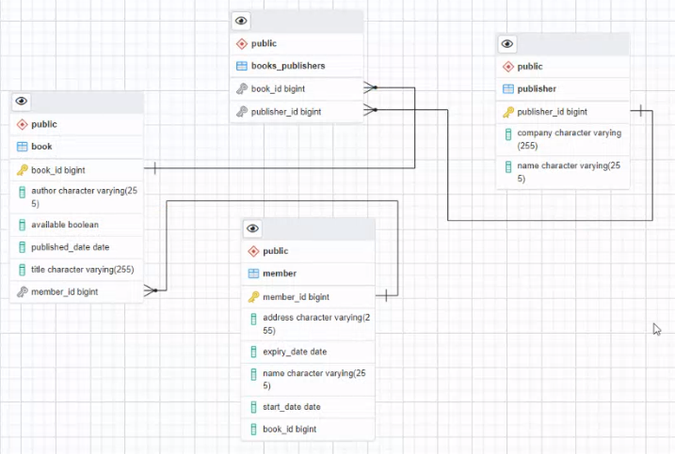
ER Diagram

Slide 7
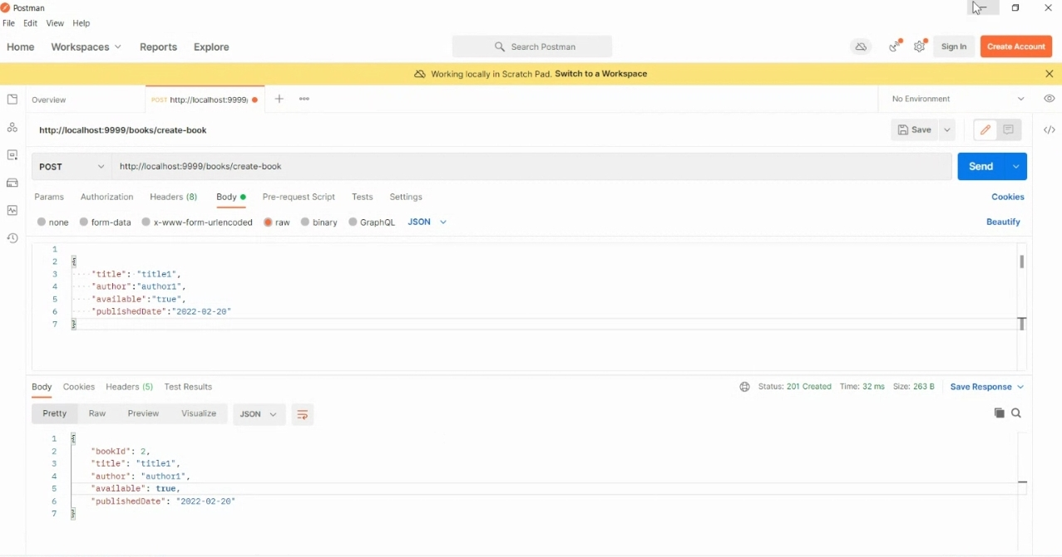
Project Description
Create Book Entry
-User can create book entry here by giving value(book id, title, author, available, published date).

Slide 8
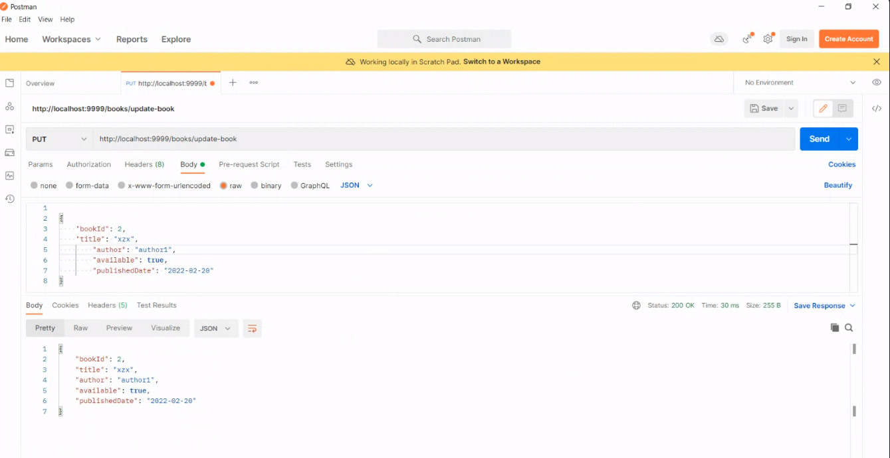
Update Book Entry
-User can update the book details.

Slide 9
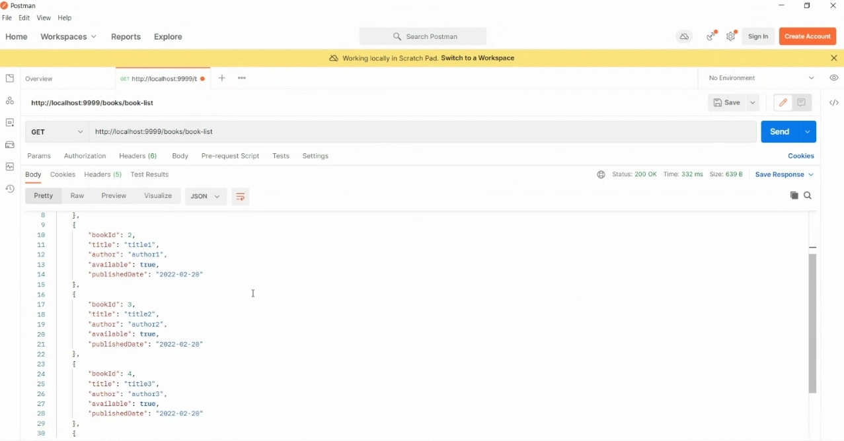
View Available Books-
User can view the available books in the library.

Slide 10
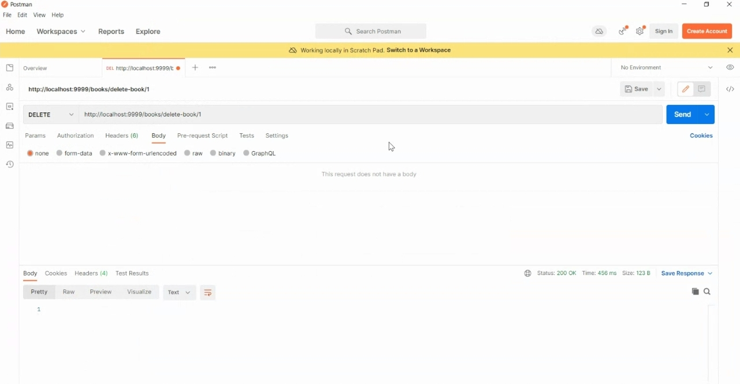
Delete Book Entries
User can remove books from the library

Slide 11
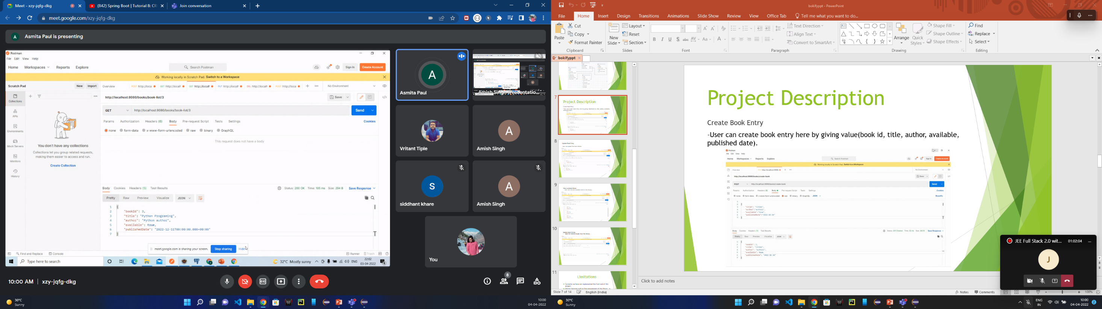
Search Book by bookId
- User can search desired book by entering the bookId

Slide 12
Limitations
Currently we have not implemented the front end of this project.
Various features such as fine management of the library is in underworks.
Advance features are not yet implemented.

Slide 13
Future Vision
Implement the front end of this project using web technologies and react framework.
Add more features such as fine management and payment gateway integration.
Adding member verification system.

Slide 14
Conclusion
The Library management system automates the process of managing records of library, thus reducing the time wasted as well as the hassles that are involved in the manual process. We analyzed different scenarios and tried to provide a solution for them. We accumulated all the feature currently used by the Library Management System apart from front end development. In this project we had to think about the various options which we can provide to user. We have tried to make this project user friendly by providing many features.
This project has a lot of potential in the future and we will work upon it.

Slide 15
Thank you
Batch
- JEE Full Stack with React JR_7

